Slide 1

Case studies, Environmental movements: Chipko, Silent valley, Bishnoi's of Rajasthan etc., Sustainable Development and Agenda 21. Biodiversity: Importance, threats and conservation. Managing Environmental challenges for future.
Information Security Fundamentals | Ecological Behaviour and Knowledge Management
Course: Information Security Fundamentals | Chapter: Ecological Behaviour and Knowledge Management | Program: Bachelor of Engineering
DISCOVER · LEARN · EMPOWER
Notes:
Welcome students to this critical session on ecological behaviour and knowledge management. We will explore how human actions directly impact our environment through historical case studies. Today, we bridge the gap between theoretical knowledge and practical environmental conservation strategies.

Slide 2
Course Outcomes
SLIDE 2 / 14
Course Outcome
CO | BT LEVEL | DESCRIPTION
CO1 | BT4 | Recall, analyze and respond on fundamental environmental principles, such as ecological relationships and conservation strategies
CO2 | BT4 | Understand and analyze the interconnections between human activities and environmental impacts across different ecosystems
CO3 | BT4 | Understand and analyze and apply environmental laws and policies to analyse and propose solutions for real-world environmental challenges.
CO4 | BT2 | Students will analyse data from environmental monitoring programs to assess trends and predict future impacts on ecosystems.
CO5 | BT6 | Interpret, elaborate and propose various tools, design and innovative strategies for sustainable development and environmental conservation initiatives in securing the planet.
Chandigarh University
2 / 14
Notes:
This lecture directly addresses Course Outcome 4, which focuses on data analysis and trend prediction. We will examine how monitoring data from movements like Chipko informs our understanding of ecosystem health. By the end, you will see how to interpret environmental data to predict future impacts.

Slide 3
Learning Objectives
SLIDE 3 / 14
Learning Outcomes
1
Identify key environmental movements like Chipko and Bishnoi as knowledge management examples.
2
Explain the significance of Agenda 21 in promoting sustainable development globally.
3
Describe the importance of biodiversity and list major threats to ecosystem stability.
4
Analyze conservation strategies used in the Silent Valley movement for future application.
5
Evaluate methods for managing environmental challenges to ensure long-term sustainability.
Chandigarh University
3 / 14
Notes:
By the end of this session, you will be able to identify how specific movements serve as knowledge management tools. We will explain the global framework of Agenda 21 and its role in sustainable development. You will also analyze the threats to biodiversity and evaluate conservation strategies for future challenges.

Slide 4
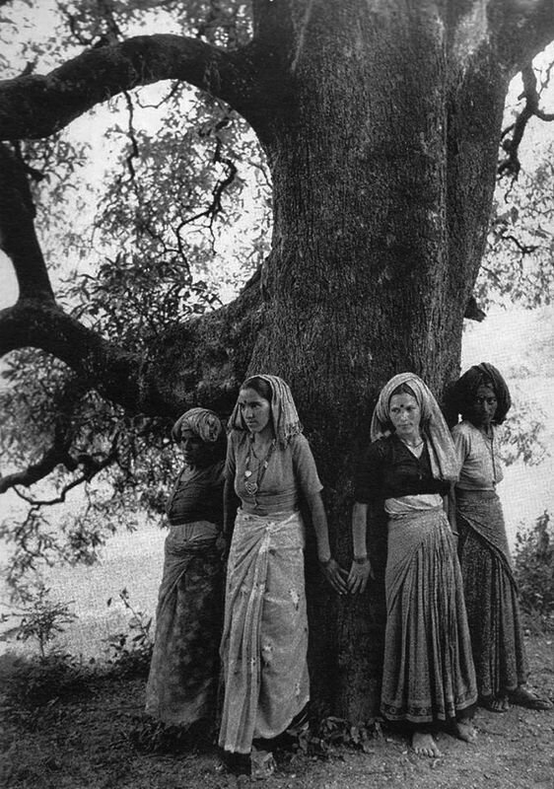
The Chipko Movement
SLIDE 4 / 14
Community Knowledge
1
Chipko was a non-violent movement where villagers hugged trees to prevent logging.
2
It demonstrated how local ecological knowledge can effectively manage forest resources sustainably.
3
The movement started in Reni village, Uttarakhand, in 1973 to protect Himalayan forests.
4
It highlighted the link between forest conservation and the livelihoods of rural communities.
5
This case study shows how collective action preserves ecological balance and biodiversity.
6
Knowledge management here involved sharing traditional practices of sustainable forest usage.
Pamela Singh: Chipko Tree Huggers of the Himalayas — sepiaEYE
Chandigarh University
4 / 14
Notes:
The Chipko movement is a prime example of ecological behaviour driven by community knowledge. In 1973, women in Reni village hugged trees to stop loggers, proving that local knowledge is a powerful management tool. This action preserved the forest, which is crucial for the region's biodiversity and water cycles.

Slide 5
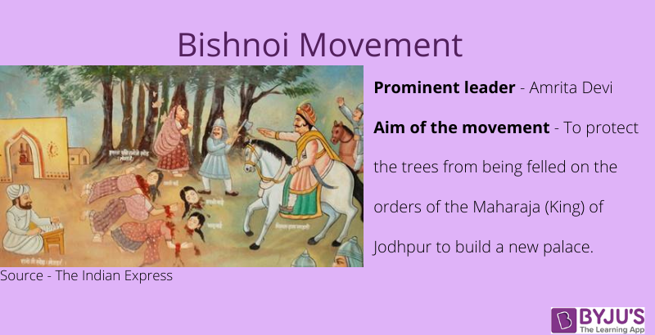
Bishnoi Movement
SLIDE 5 / 14
Sacrifice for Nature
1
The Bishnoi community in Rajasthan follows 29 principles including total protection of nature.
2
They famously sacrificed their lives to protect Khejri trees from being cut down.
3
In 1730, Amrita Devi led 363 followers to die protecting trees from the King's orders.
4
Their actions established a legal precedent for environmental protection in Indian law.
5
This movement illustrates deep cultural integration of ecological behaviour and knowledge.
6
It serves as a historical benchmark for modern conservation efforts and biodiversity protection.
About Bishnoi Movement (source: cdn1.byjus.com)
Chandigarh University
5 / 14
Notes:
The Bishnoi movement in Rajasthan is a testament to the power of cultural knowledge in conservation. In 1730, Amrita Devi and 363 followers sacrificed their lives to protect Khejri trees, setting a legal precedent. This deep integration of faith and ecology shows how knowledge management can drive extreme conservation outcomes.

Slide 6
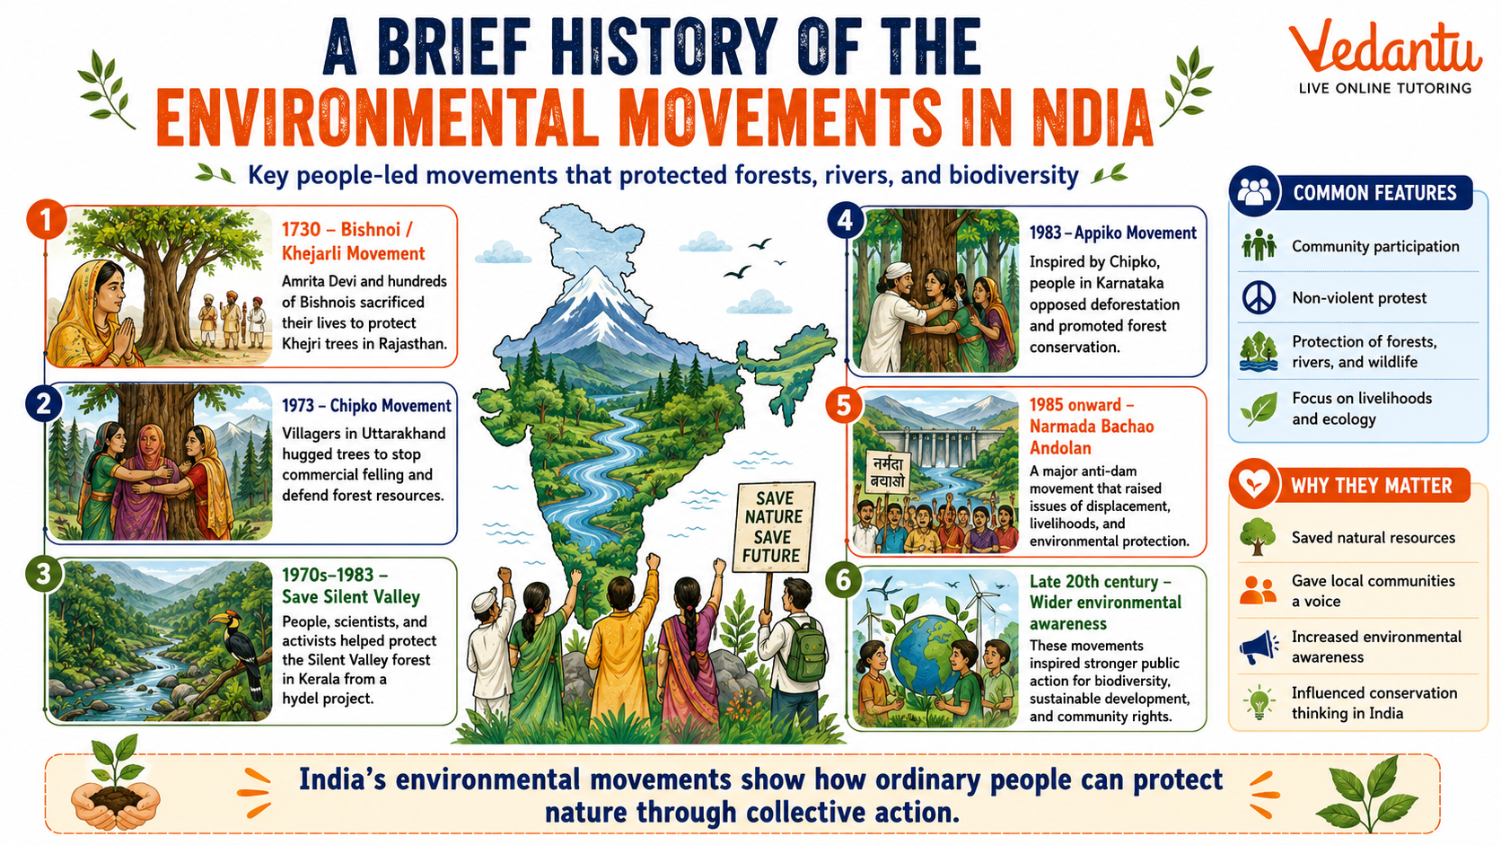
Silent Valley
SLIDE 6 / 14
Preventing Ecological Loss
1
The Silent Valley movement aimed to stop a hydroelectric project in Kerala's rainforest.
2
It successfully halted the project to preserve the unique endemic species of the region.
3
The movement highlighted the threat of habitat destruction to biodiversity and ecosystems.
4
It led to the establishment of the Silent Valley National Park in 1980.
5
This case study emphasizes the need for environmental impact assessments before development.
6
It shows how public awareness can influence policy to protect critical biodiversity hotspots.
A Brief History of Environmental Movements in India (source: www.vedantu.com)
Chandigarh University
6 / 14
Notes:
The Silent Valley movement in Kerala was a pivotal moment for preventing ecological loss. Activists stopped a hydroelectric project to save the unique endemic species of the rainforest. This led to the creation of the Silent Valley National Park, demonstrating that public awareness can effectively influence policy to protect biodiversity.

Slide 7
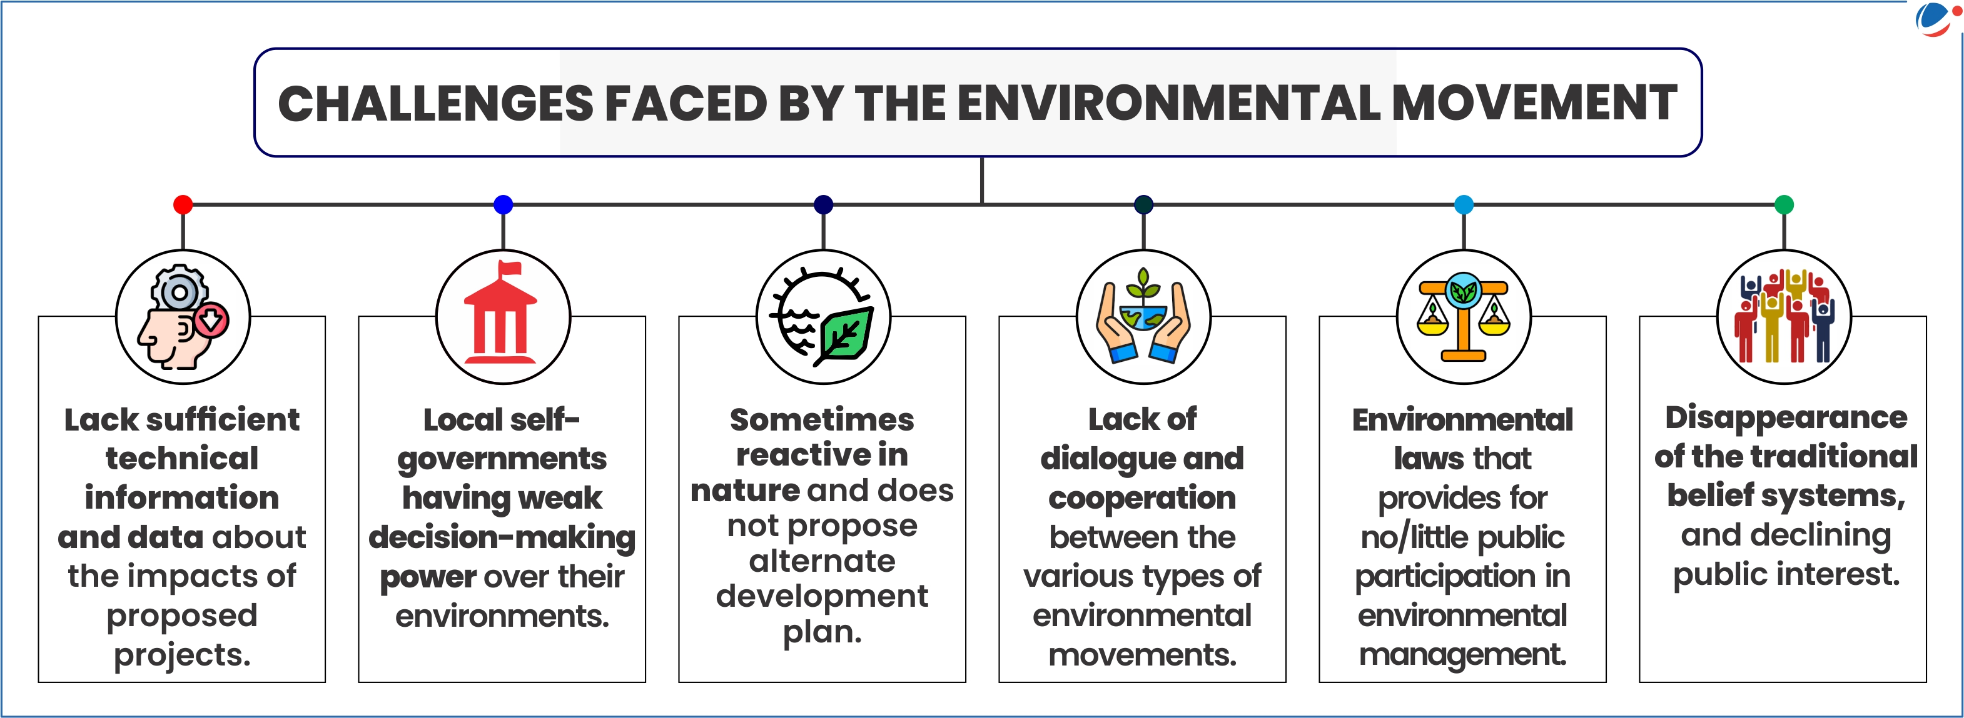
Lecture
SLIDE 7 / 14
Sustainable Development and Agenda 21
1
Sustainable development meets present needs without compromising future generations' ability to meet theirs.
2
Agenda 21 is a comprehensive action plan adopted at the 1992 Earth Summit in Rio.
3
It provides a blueprint for achieving sustainable development in the 21st century globally.
4
The agenda covers social, economic, and environmental dimensions of development and conservation.
5
It emphasizes local action plans to manage waste, water, and biodiversity effectively.
6
Implementing Agenda 21 requires integrating ecological knowledge into all policy decisions.
Environmental Movements in India | Current Affairs | Vision IAS (source: d2av8kbir6lh9m.cloudfront.net)
Chandigarh University
7 / 14
Notes:
Sustainable development is defined as meeting present needs without compromising future generations. Agenda 21, adopted at the 1992 Earth Summit, provides a global blueprint for this. It covers social, economic, and environmental dimensions, emphasizing that local action plans are essential for managing waste and biodiversity effectively.

Slide 8
Biodiversity
SLIDE 8 / 14
Importance and Ecosystem Services
1
Biodiversity refers to the variety of life forms in a specific area or on Earth.
2
It provides essential ecosystem services like pollination, water purification, and soil fertility.
3
High biodiversity increases ecosystem resilience against disturbances and climate change impacts.
4
It is a source of genetic material for agriculture, medicine, and industrial products.
5
Loss of biodiversity reduces the capacity of ecosystems to support human life.
6
Conserving biodiversity is critical for maintaining the balance of ecological systems.
A Brief History of Environmental Movements in India (source: www.vedantu.com)
Chandigarh University
8 / 14
Notes:
Biodiversity is the variety of life forms that provides essential ecosystem services like pollination and water purification. High biodiversity increases ecosystem resilience against disturbances and climate change. It is also a source of genetic material for agriculture and medicine, making its conservation critical for human survival.

Slide 9
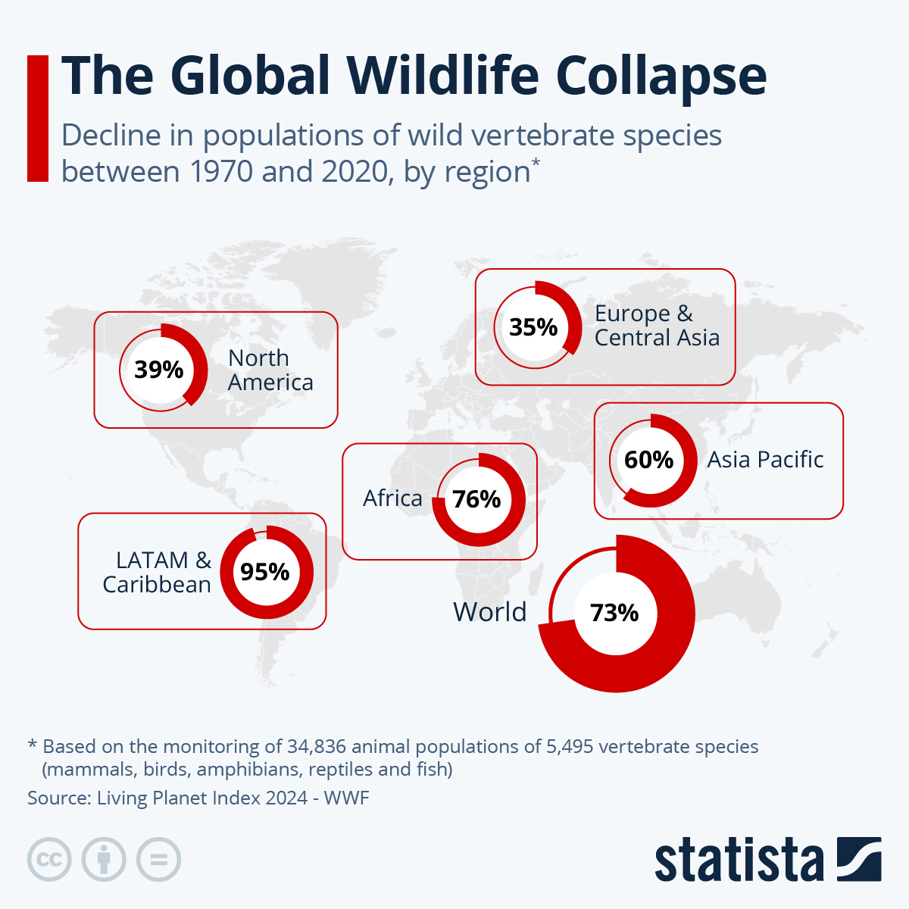
Threats to Biodiversity
SLIDE 9 / 14
Quantitative Analysis
1
Habitat loss is the primary threat, causing a 70% decline in global wildlife populations.
2
Invasive species can outcompete native species, reducing local biodiversity by up to 50%.
3
Pollution degrades ecosystems, leading to a 30% reduction in water quality in affected areas.
4
Climate change alters habitats, forcing species migration and increasing extinction risks significantly.
5
Overexploitation leads to population crashes, such as the 90% decline in Atlantic cod stocks.
6
These threats act synergistically, accelerating the rate of biodiversity loss globally.
Source: cdn.statcdn.com
Chandigarh University
9 / 14
Notes:
Habitat loss is the primary threat, causing a 70% decline in global wildlife populations. Invasive species can reduce local biodiversity by up to 50%, while pollution degrades water quality by 30%. Overexploitation has led to population crashes, such as the 90% decline in Atlantic cod stocks, showing the severity of these threats.

Slide 10
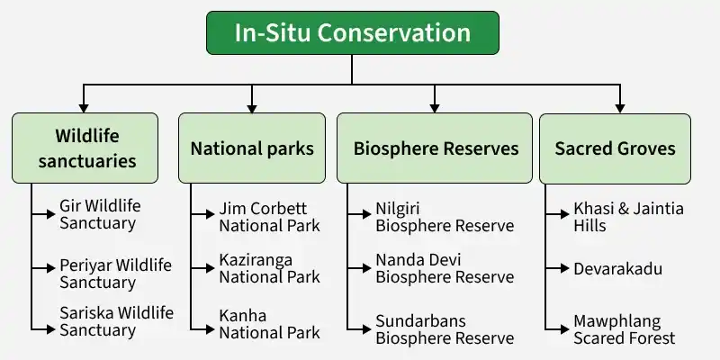
Conservation Strategies
SLIDE 10 / 14
In-situ and Ex-situ
1
In-situ conservation protects species in their natural habitats like national parks and sanctuaries.
2
Ex-situ conservation involves breeding programs in zoos and botanical gardens for endangered species.
3
Protected areas cover about 15% of the Earth's land surface for conservation efforts.
4
Community-based conservation empowers locals to manage resources and protect biodiversity.
5
Legislation like the Wildlife Protection Act provides legal frameworks for species protection.
6
Combining both strategies maximizes the chances of species survival and recovery.
Source: media.geeksforgeeks.org
Chandigarh University
10 / 14
Notes:
In-situ conservation protects species in their natural habitats like national parks, while ex-situ conservation uses zoos for breeding programs. Protected areas cover about 15% of the Earth's land surface. Community-based conservation empowers locals to manage resources, and legislation provides legal frameworks, making a combined approach essential for recovery.

Slide 11
Managing Environmental Challenges
SLIDE 11 / 14
Numerical Example
GOVERNING EQUATION
Formula: Reduction % = ((100 - 60) / 100) × 100 = 40%
EXAMPLE
Reducing waste from 100 tons to 60 tons requires a 40% reduction rate.
• To manage waste, calculate the reduction needed: (Current Waste - Target Waste) / Current Waste.
• This calculation helps set realistic targets for municipal waste management programs.
• Monitoring these metrics ensures progress towards sustainable development goals.
• Data analysis allows for predictive modeling of future environmental impacts.
Environmental Movements in India | Current Affairs | Vision IAS (source: d2av8kbir6lh9m.cloudfront.net)
Chandigarh University
11 / 14
Notes:
To manage waste, we calculate the reduction needed using the formula: (Current Waste - Target Waste) / Current Waste. For example, reducing waste from 100 tons to 60 tons requires a 40% reduction rate. This calculation helps set realistic targets for municipal waste management programs and ensures progress towards sustainable development goals.

Slide 12
Lecture
SLIDE 12 / 14
Common Pitfalls in Environmental Management
1
Ignoring local ecological knowledge leads to ineffective and unsustainable management strategies.
2
Focusing only on short-term economic gains often results in long-term ecological damage.
3
Lack of data monitoring prevents accurate assessment of trends and future impacts.
4
Inadequate community engagement causes resistance to conservation initiatives and policies.
5
Over-reliance on technology without understanding ecological principles can cause failures.
6
Failure to integrate Agenda 21 principles leads to fragmented and inconsistent actions.
A Brief History of Environmental Movements in India (source: www.vedantu.com)
Chandigarh University
12 / 14
Notes:
Ignoring local ecological knowledge leads to ineffective strategies, while focusing only on short-term gains causes long-term damage. Lack of data monitoring prevents accurate assessment of trends, and inadequate community engagement causes resistance. Over-reliance on technology without understanding ecological principles can cause failures, highlighting the need for integrated approaches.

Slide 13
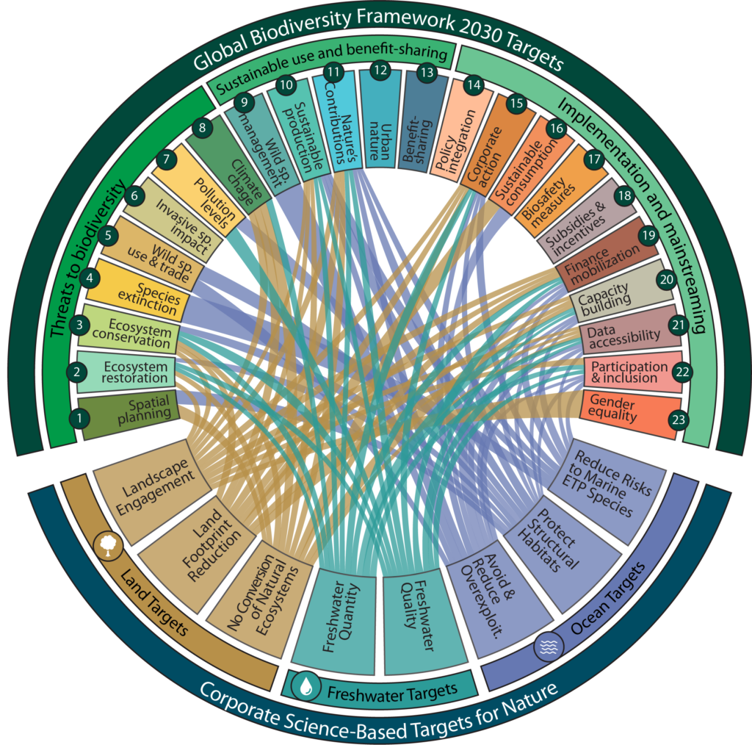
Lecture
SLIDE 13 / 14
Key Takeaways
1
Environmental movements like Chipko and Bishnoi demonstrate the power of community knowledge.
2
Agenda 21 provides a global framework for sustainable development and biodiversity conservation.
3
Biodiversity is essential for ecosystem services and must be protected from major threats.
4
Effective management requires quantitative analysis and realistic target setting for waste reduction.
5
Integrating local knowledge with scientific data is crucial for future environmental success.
Source: sciencebasedtargetsnetwork.org
Chandigarh University
13 / 14
Notes:
Environmental movements like Chipko and Bishnoi demonstrate the power of community knowledge in conservation. Agenda 21 provides a global framework for sustainable development, while biodiversity remains essential for ecosystem services. Effective management requires quantitative analysis and realistic target setting, integrating local knowledge with scientific data for future success.

Slide 14
Lecture
SLIDE 14 / 14
References
ENVIRONMENTAL STUDIES
From Crisis to Cure — R. Rajagopalan
• Environmental Science and Engineering — Benny Joseph
• Environmental Studies — R.C. Sharma and D. Gurbir Sangha
• Introduction to Environmental Science — Anjaneyulu, Y.
• Environmental Pollution Control Engineering — C.S. Rao
• Textbook of Environmental Studies for undergraduate courses — E. Bharucha
• Environmental Science — S.C. Santra
Chandigarh University
14 / 14
Notes:
These references provide comprehensive coverage of environmental science and engineering principles. Benny Joseph's work offers foundational knowledge, while R.C. Sharma and D. Gurbir Sangha provide detailed studies. Anjaneyulu, C.S. Rao, E. Bharucha, R. Rajagopalan, and S.C. Santra offer further insights into pollution control and sustainable practices.

